Slide 1

G4SE1831 – Summer 2024
IoT-Based Intrusion Detection System Using
NodeMCU and Arduino
Notes:
1

Slide 2

Group Members
Supervisor:
👤 Mr. Nguyễn Trí Thông
Group Members:
👤Bùi Minh Thắng - SE180564
👤Bùi Anh Kha - SE181730
👤Đào Công An Phước - SE180581
👤Nguyễn Anh Quân - SE180619
Notes:
2

Slide 3

Table Of Contents
I
V
Project Context
Circuit map
II
VI
Our Solution
Flow chart
III
VII
Block diagram
Conclusion
IV
VIII
Functions of the parts
Future development
Notes:
2

Slide 4

Project Context
Safety and privacy have always been significant concerns for many families and businesses. In today's era, with the development of smart devices, theft and unauthorized intrusions have become increasingly sophisticated. This necessitates more effective and convenient security solutions. Integrating IoT technology into security systems enhances the ability to monitor and respond promptly to threats, providing optimal protection and peace of mind for users in all situations.

Slide 5
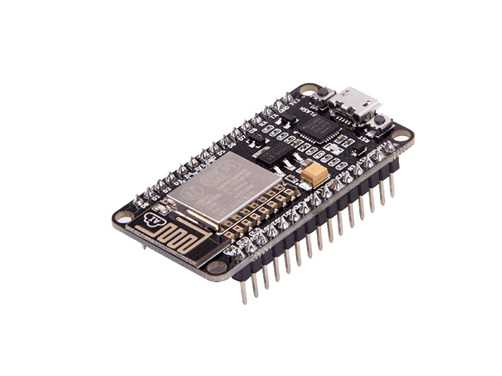
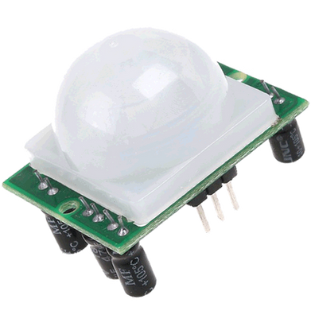

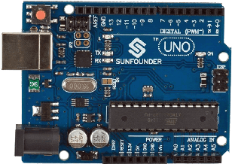

Our solutions
PIR for motion detection
Send notification to user and allowing the system to be controlled by phone
Central processing unit

Slide 6
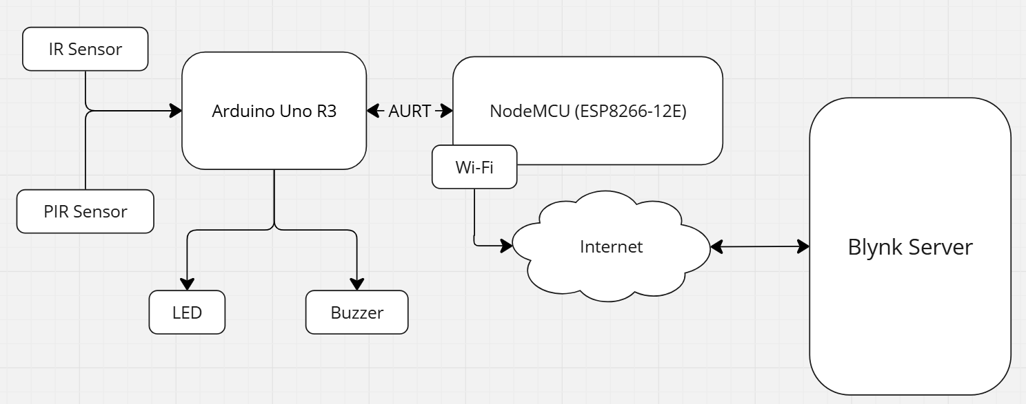
BlockDiagram
This block diagram represents a system that includes sensors, an Arduino microcontroller, a NodeMCU Wi-Fi module, and a Blynk server for remote monitoring and control.

Slide 7

Function of parts
Central processing unit used to interface with the sensors and to process the data received from them
The NodeMCU connects to the internet via Wi-Fi.
This allows data from the Arduino to be sent to the Blynk server.
A Passive Infrared sensor used for detecting motion. It measures infrared light radiating from objects in its field of view

Slide 8
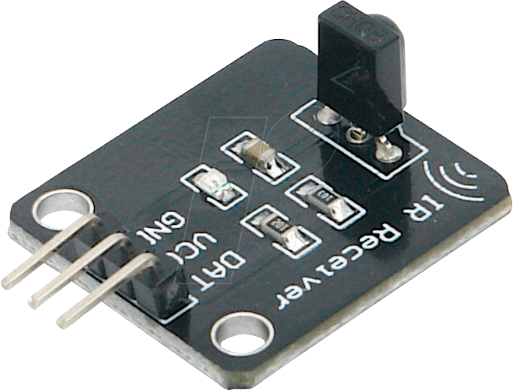
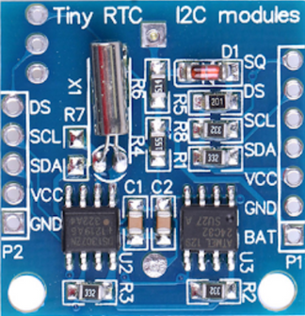
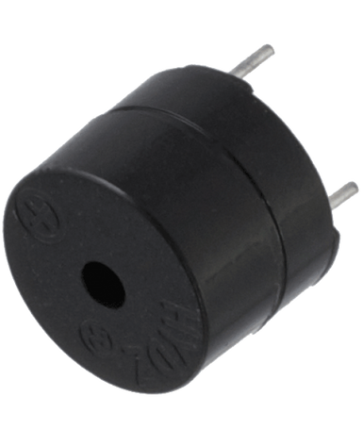
Function of parts
Infrared receiver for remote
A real-time clock module used for keeping track of time. It helps in time-stamping the events
An audio signaling device used to produce sound to alert.

Slide 9
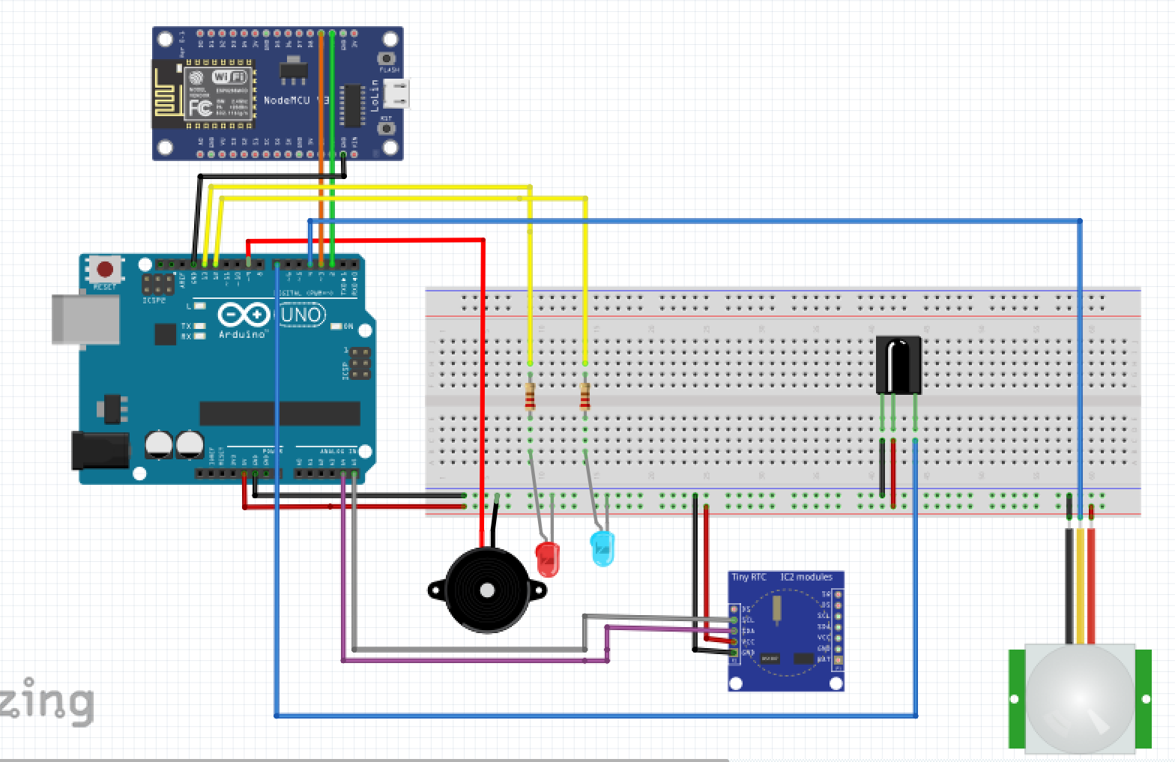
Circuit Map

Slide 10
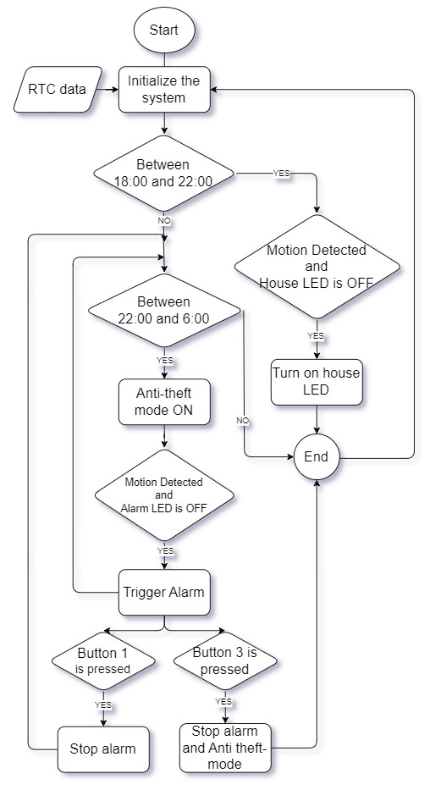
FlowChart

Slide 11
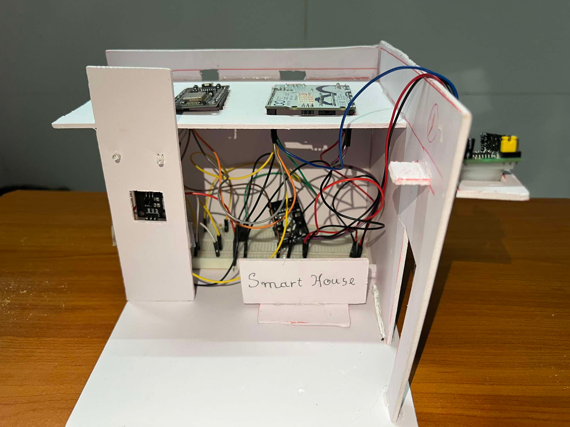


Product Image
https://youtu.be/hjgtLL5D074?feature=shared

Slide 12
Conclusion
Successfully integrating modern technology to enhance home security and convenience. |  | The system provides real-time monitoring and immediate alerts, significantly improving the response time to potential intrusions. |  | This result affirms the potential of IoT technology in creating advanced, reliable, and easy-to-deploy security systems, providing peace of mind for users.

Slide 13
INTEGRATION WITH CLOUD SERVICES
ENHANCED SENSOR NETWORK
INTEGRATION WITH OTHER SMART HOME DEVICES
AI AND MACHINE LEARNING
Future Directions

Slide 14
Q&A

Slide 15
THANK YOU

